Slide 1
Computer graphics III
Path tracing
Jaroslav Křivánek, MFF UK
Jaroslav.Krivanek@mff.cuni.cz

Slide 2
Tracing paths from the (pinhole) camera
  renderImage()
  {
  for all pixels
  {
    Spectrum pixelColor = (0,0,0);
    for k = 1 to N
    {
      ω_{k} := random direction through the pixel
      pixelColor += estimateLin(cameraPosition, ω_{k})
    }
    pixelColor /= N;
    writePixel(k, pixelColor);
    }
  }

Slide 3
Tracing paths from the (pinhole) camera
For progressive rendering, swap the loop nesting:
  renderImage()
  {
    for k = 1 to N // rendering “passes”
    {
  for all pixels
  {
    Spectrum pixelColor = (0,0,0);
    ...

Slide 4
Path tracing, v. 0.1
estimateLin (x, ω): // radiance incident at x from direction ω
y = findNearestIntersection(x, ω)
if (no intersection)
return backgroud.getLe (y, –ω) // emitted radiance from envmap
else
return getLe (y, –ω) + // emitted radiance (if y is on a light)
estimateLrefl (y, –ω)// reflected radiance
estimateLrefl(x, ω_{out}):
[ω_{in} , pdf] = genRandomDir(x, ω_{out}); // e.g. BRDF imp. sampling
return estimateLin(x, ω_{in}) * brdf(x, ω_{in}, ω_{out}) * dot(n_{x}, ω_{in}) / pdf

Slide 5
Path Tracing – Loop version
Path tracing only has tail recursion
  Can be unrolled into a loop for better efficiency
New feature: “Russian Roulette” for unbiased path termination

Slide 6
estimateLin(x, omegaInAtX) // radiance incident at “x” from the direction “omegaInAtX”
{ // (“omegaInAtX” is pointing *away* from “x”)
Spectrum throughput = (1,1,1)
Spectrum accum = (0,0,0)
while(1)
{
hit = findNearestIntersection(x, omegaInAtX)
if noIntersection(hit) // ray leaves the scene – it “hits” the background
return accum + throughput * bkgLight.getLe(x, - omegaInAtX)
omegaOut := -omegaInAtX // omegaOut at hit.pos
if isOnLightSource(hit) // ray happened to directly hit a light source
accum += throughput * getLe(hit.pos, omegaOut) // “pick up” emission
// now estimate the reflected radiance
[omegaIn, pdfIn] := generateRandomDir(hit) // omegaIn at hit.pos
throughput *= 1/pdfIn * brdf(hit.pos, omegaIn, omegaOut) * dot(hit.n, omegaIn)
x := hit.pos // “recursion”
omegaInAtX := omegaIn // “recursion”
}
return accum;
}

Slide 7
estimateLin(x, omegaInAtX) // radiance incident at “x” from the direction “omegaInAtX”
{ // (“omegaInAtX” is pointing *away* from “x”)
Spectrum throughput = (1,1,1)
Spectrum accum = (0,0,0)
while(1)
{
hit = findNearestIntersection(x, omegaInAtX)
if noIntersection(hit) // ray leaves the scene – it “hits” the background
return accum + throughput * bkgLight.getLe(x, - omegaInAtX)
omegaOut := -omegaInAtX // omegaOut at hit.pos
if isOnLightSource(hit) // ray happened to directly hit a light source
accum += throughput * getLe(hit.pos, omegaOut) // “pick up” emission
// now estimate the reflected radiance
[omegaIn, pdfIn] := generateRandomDir(hit) // omegaIn at hit.pos
throughput *= 1/pdfIn * brdf(hit.pos, omegaIn, omegaOut) * dot(hit.n, omegaIn)
survivalProb = min(1, throughput.maxComponent())
if rand() < survivalProb // Russian Roulette – survive (reflect)
throughput /= survivalProb
x := hit.pos // “recursion”
omegaInAtX := omegaIn // “recursion”
else // terminate the path – break the while loop
break;
}
return accum;
}

Slide 8
Terminating paths – Russian roulette
Continue the path with probability q
Multiply weight (throughput) of surviving paths by 1 / q
RR is unbiased!

Slide 9
Survival probability
It makes sense to use the surface reflectance ρ as the survival probability
  If the surface reflects only 30% of light energy,
  we continue with the probability of 30%. That’s how light behaves in physical reality.

Slide 10
Survival probability
What if we cannot calculate ρ? Then there’s a convenient alternative, which in fact works even better:
  First sample a random direction ω_{in} according to pdf(ω_{in})
  Update the path throughput
  Use the updated throughput as the survival probability
If direction sampling pdf(ω_{in}) is exactly proportional to BRDF*cos, the above strategy turns out to be exactly equivalent to setting survival probability to the surface reflectance (prove this).

Slide 11
Survival probability
Our work: Adjoint-driven Russian Roulette & Splititng [Vorba & Křivánek 2016]
  Weight the survival probability by the expected path contribution
    If we enter a bright region, continue path even if throughput might be low
    If we enter a dark region, kill the path even if throughput might be high
  If the “survival probability” ends up > 1, split the path

Slide 12
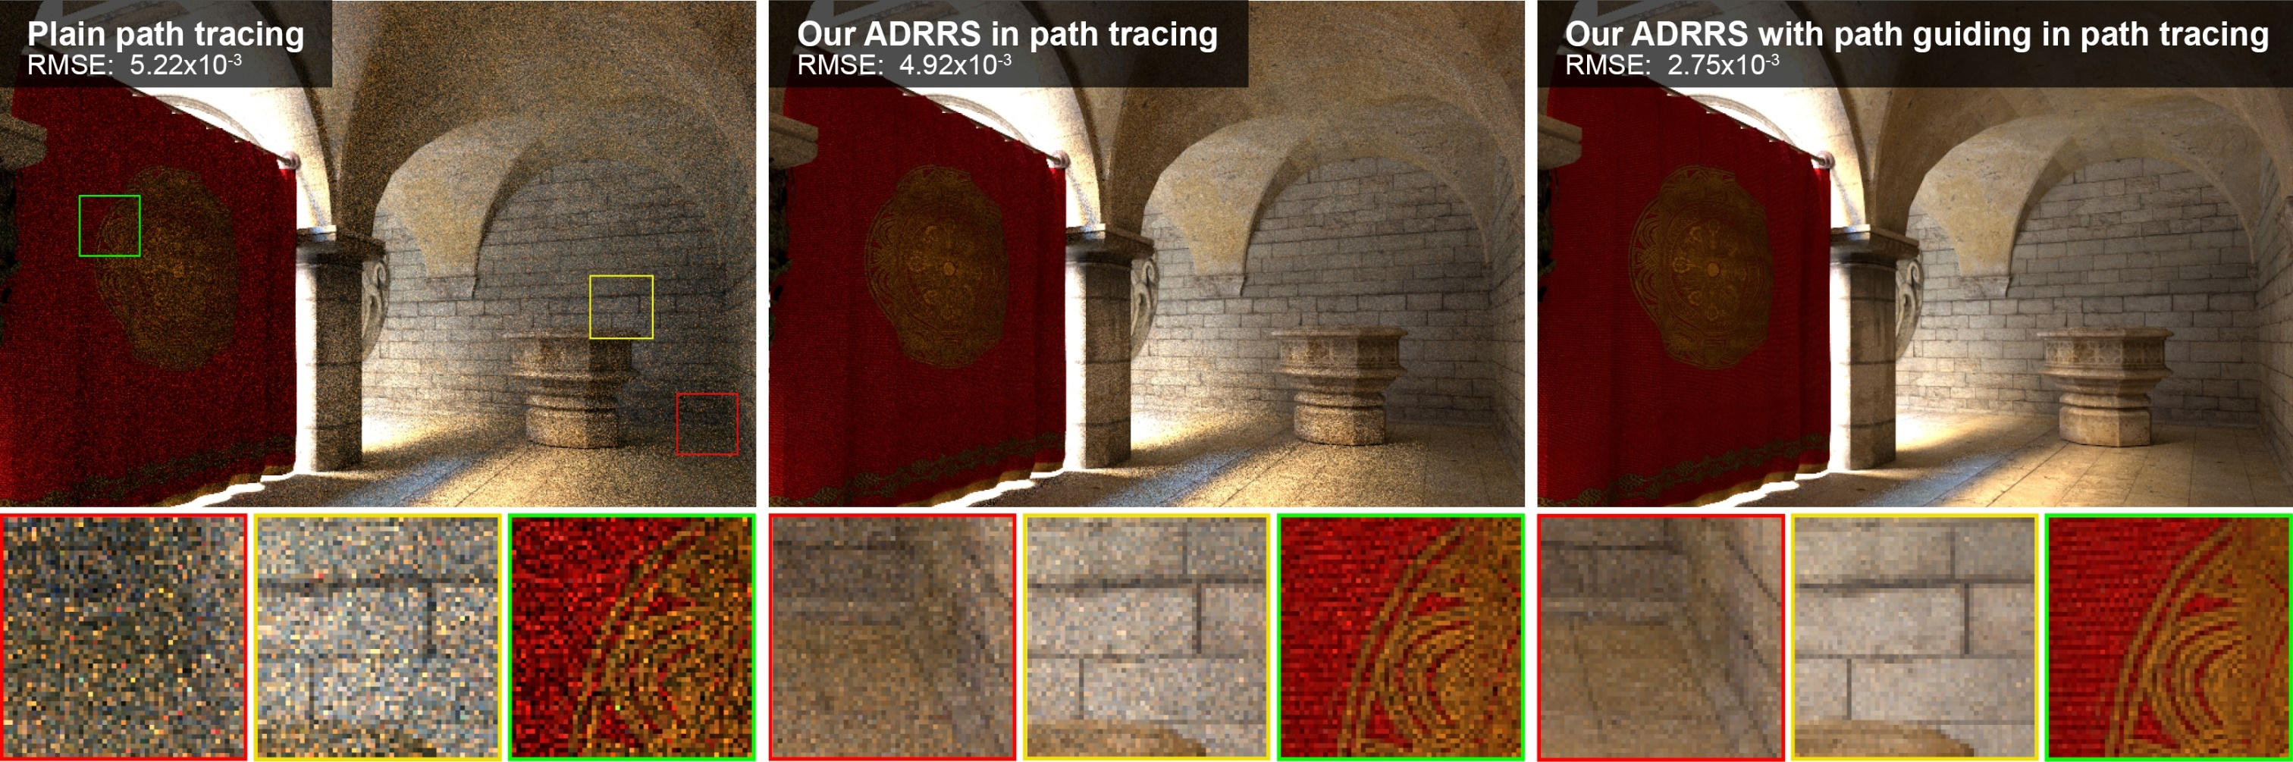
Adjoint-drive RR and splitting
Vorba and Křivánek. Adjoint-Driven Russian Roulette and Splitting in Light Transport Simulation. ACM SIGGRAPH 2016

Slide 13
estimateLin(x, omegaInAtX) // radiance incident at “x” from the direction “omegaInAtX”
{ // (“omegaInAtX” is pointing *away* from “x”)
Spectrum throughput = (1,1,1)
Spectrum accum = (0,0,0)
while(1)
{
hit = findNearestIntersection(x, omegaInAtX)
if noIntersection(hit) // ray leaves the scene – it “hits” the background
return accum + throughput * bkgLight.getLe(x, - omegaInAtX)
omegaOut := -omegaInAtX // omegaOut at hit.pos
if isOnLightSource(hit) // ray happened to directly hit a light source
accum += throughput * getLe(hit.pos, omegaOut) // “pick up” emission
// now estimate the reflected radiance
[omegaIn, pdfIn] := generateRandomDir(hit) // omegaIn at hit.pos
throughput *= 1/pdfIn * brdf(hit.pos, omegaIn, omegaOut) * dot(hit.n, omegaIn)
survivalProb = min(1, throughput.maxComponent())
if rand() < survivalProb // Russian Roulette – survive (reflect)
throughput /= survivalProb
x := hit.pos // “recursion”
omegaInAtX := omegaIn // “recursion”
else // terminate the path – break the while loop
break;
}
return accum;
}

Slide 14
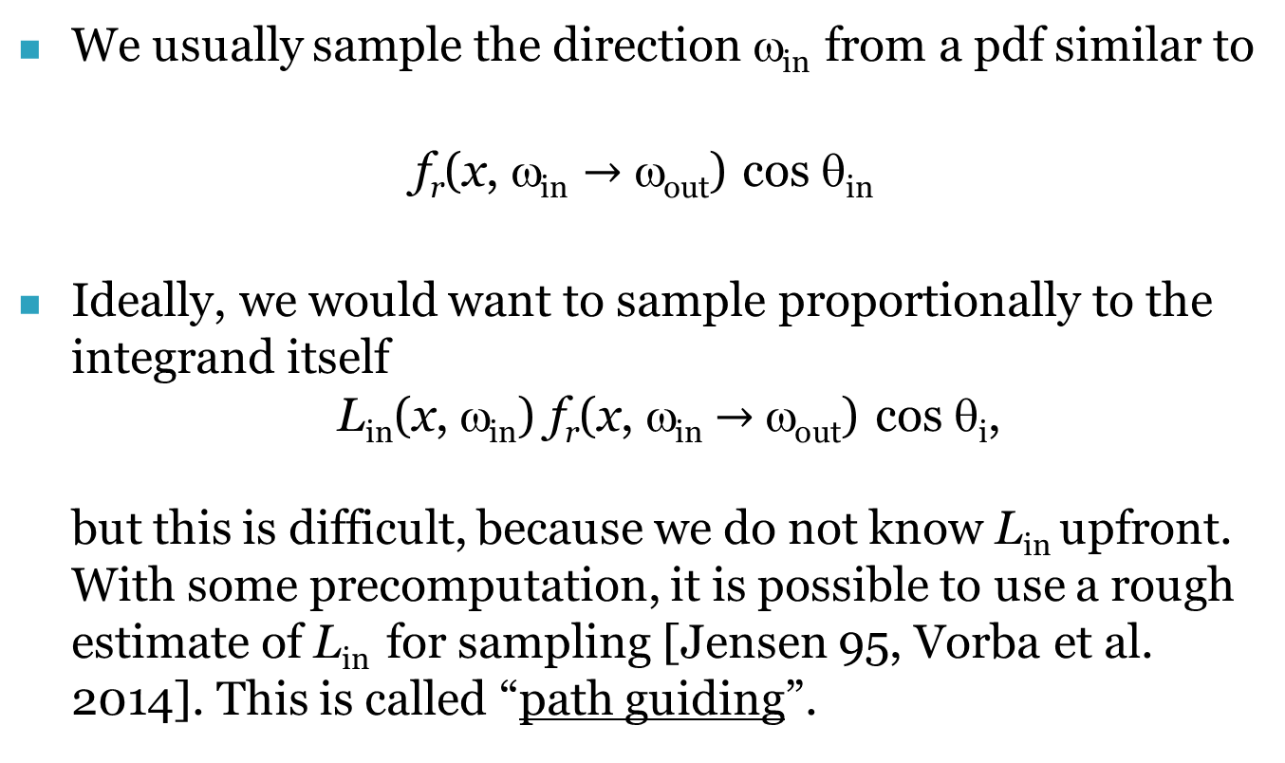
Direction sampling – genRandomDir()
We usually sample the direction ω_{in} from a pdf similar to
f_{r}(x, ω_{in} $→$ ω_{out}) cos θ_{in}
Ideally, we would want to sample proportionally to the integrand itself
L_{in}(x, ω_{in}) f_{r}(x, ω_{in}$→$ω_{out}) cos θ_{i},
but this is difficult, because we do not know L_{in} upfront.
With some precomputation, it is possible to use a rough estimate of L_{in} for sampling [Jensen 95, Vorba et al. 2014]. This is called “path guiding”.

Slide 15
Path guiding
Vorba, Karlík, Šik, Ritschel, and Křivánek. On-line Learning of Parametric Mixture Models for Light Transport Simulation. ACM SIGGRAPH 2014

Slide 16
Path guiding
Vorba, Karlík, Šik, Ritschel, and Křivánek. On-line Learning of Parametric Mixture Models for Light Transport Simulation. ACM SIGGRAPH 2014

Slide 17
Direct illumination calculation in a path tracer

Slide 18
Direct illumination: Two strategies
At each path vertex, we are calculating direct illumination
  i.e. radiance reflected from the surface point exclusively due to the light coming directly from the light sources
Two sampling strategies
  Explicit light source sampling
  (“next event estimation”)
  BRDF-proportional sampling
  (already in the above code)

Slide 19
The use of MIS in a path tracer
At each path vertex do both:
  Explicit light source sampling
    Generate point on light source & cast shadow ray
  BRDF-proportional sampling
    One ray can be shared for the calculation of both direct and indirect illumination
    But the MIS weight is applied only on the direct term
    (indirect illumination is added unweighted because there is no alternative technique to calculate it)

Slide 20
Dealing with multiple light sources
Option 1:
  Loop over all sources and send a shadow ray to each one
Option 2:
  Choose one source at random (ideally with prob proportional to light contribution)
  Sample illumination only on the chosen light, divide the result by the prob of picking that light
  (Scales better with many sources but has higher variance per path)
Beware: The probability of choosing a light influences the sampling pds and therefore also the MIS weights.

Slide 21
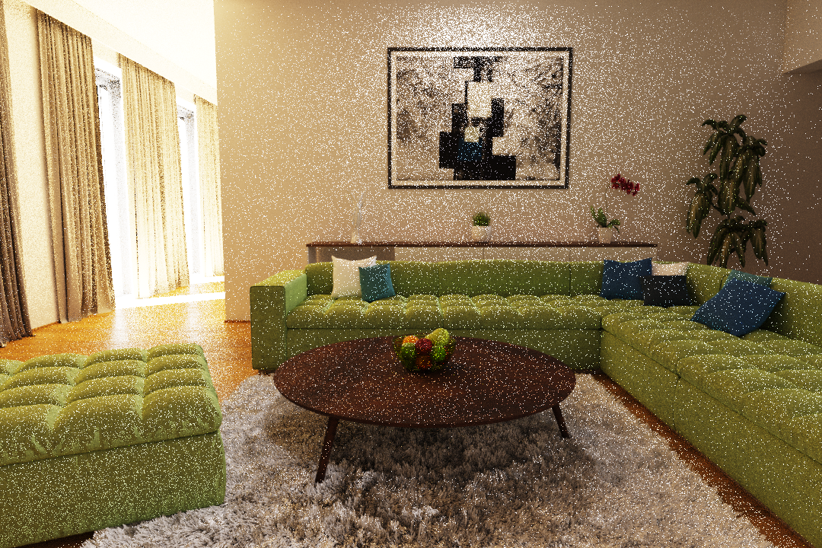
Learning the lights’ contributions
  Before (no learning)
Vévoda, Kondapaneni, Křivánek. Bayesian online regression for adaptive direct illumination sampling. ACM SIGGRAPH 2018

Slide 22
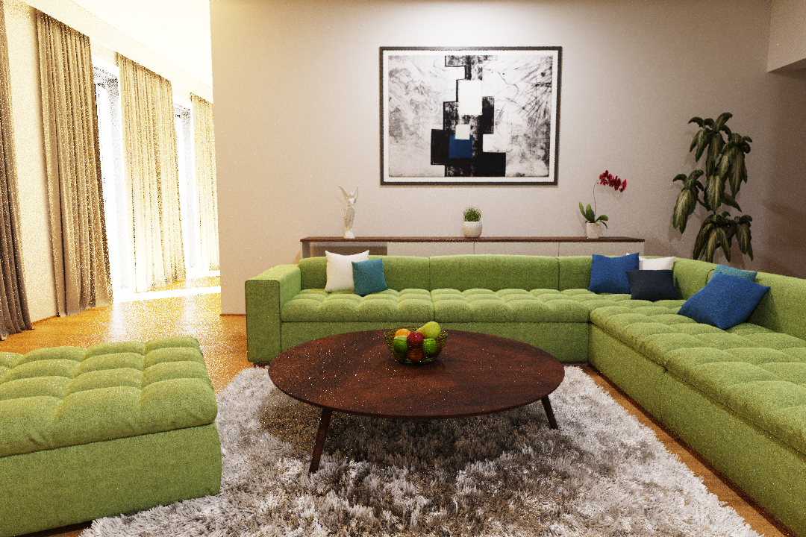
Learning the lights’ contributions
  After (with learning)
Vévoda, Kondapaneni, Křivánek. Bayesian online regression for adaptive direct illumination sampling. ACM SIGGRAPH 2018

